Slide 1
Test Partnerships
Experiences from Asking Partners to shift to Context-Driven Testing

Slide 2
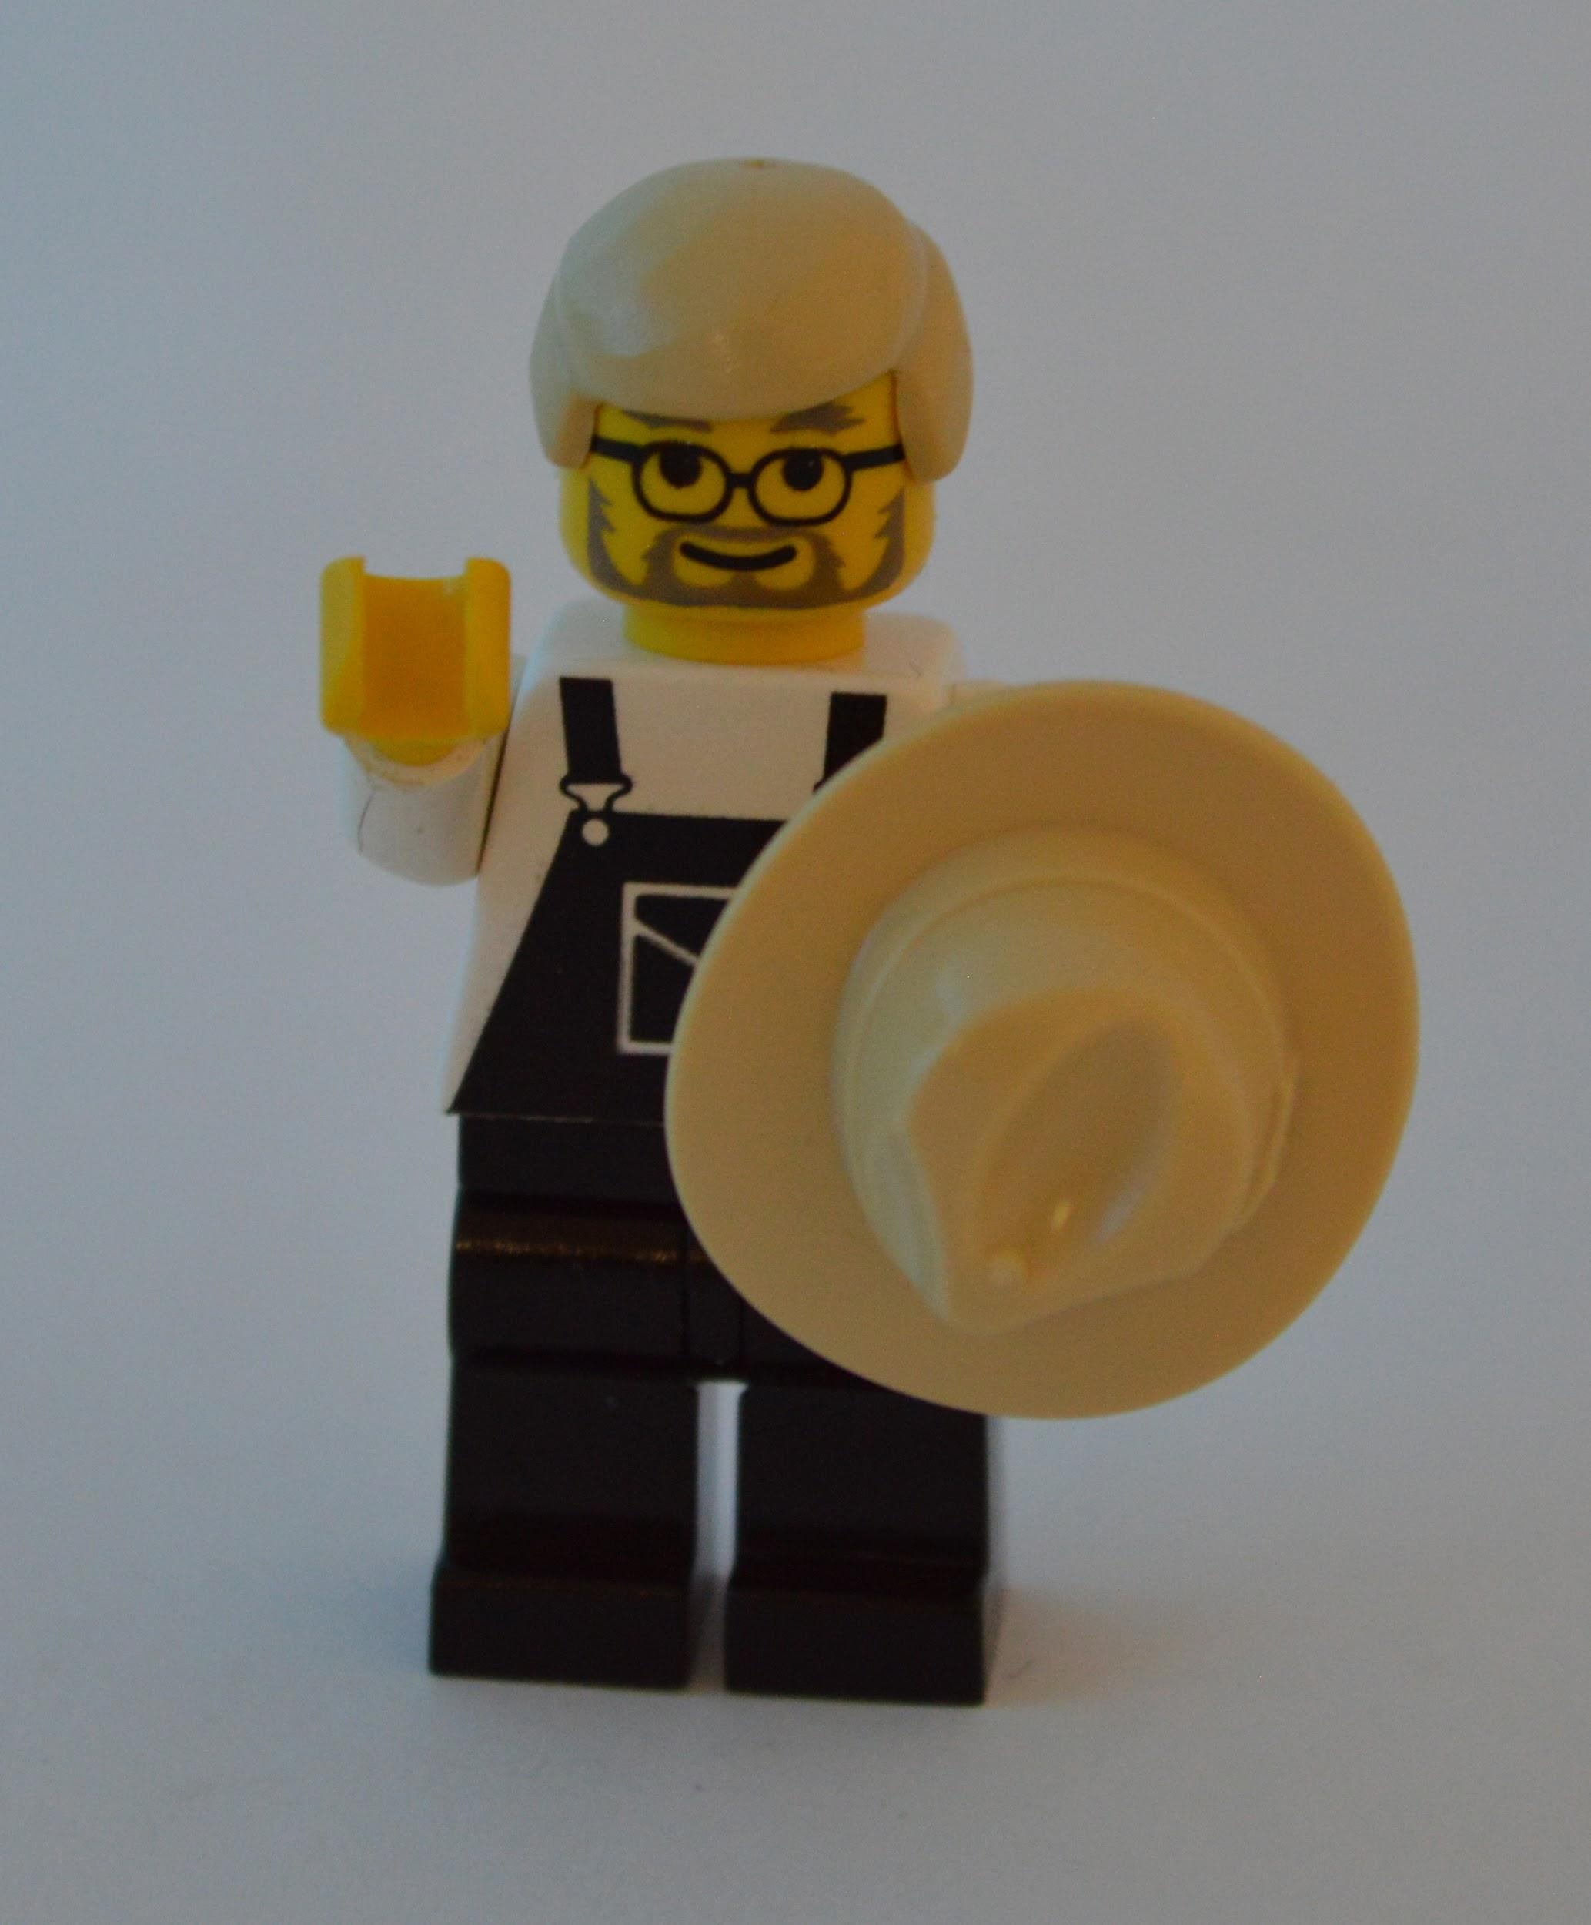

Who are we?
Phil McNeely
http://AdventuresInTesting.com
@AdvInTesting
Carl Shaulis
http://kungfutesting.blogspot.com/
@carlshaulis

Slide 3
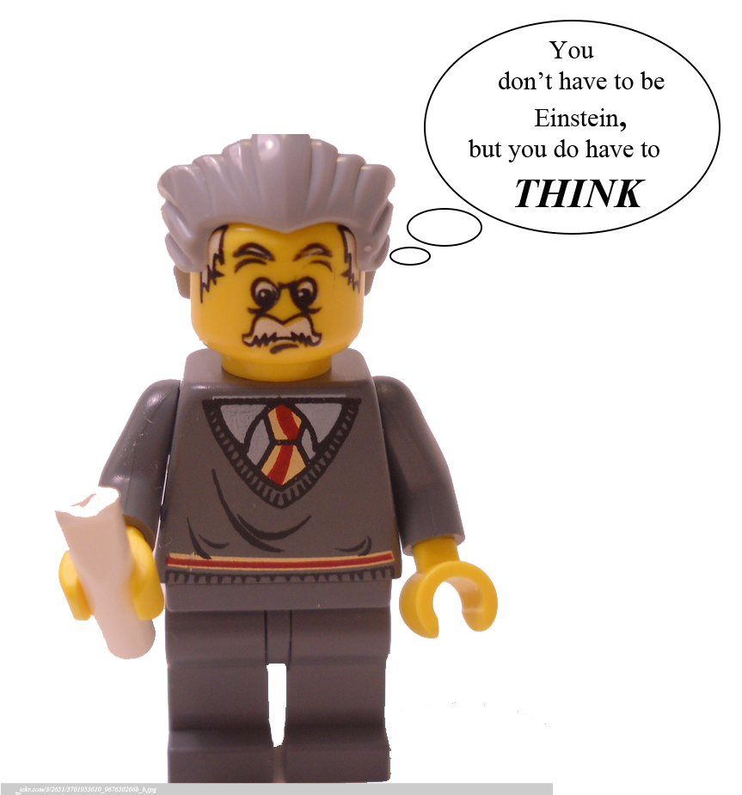

Our Context
“Projects unfold over time in ways that are often not predictable.”
“Good software testing is a challenging intellectual process.”*
*http://context-driven-testing.com/

Slide 4
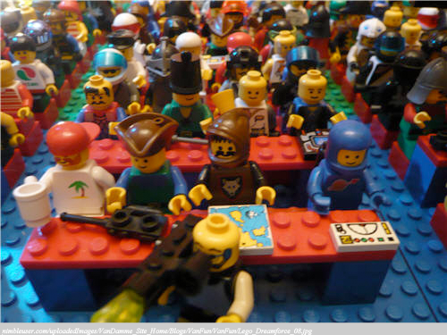
Audience Poll
Do you currently leverage test partners?
Yes
No
Would you consider your test partners to be context driven?
Yes
No
What has been your experience with test partners?
Successful
Challenging

Slide 5

2010 - 2011
Carl moves from Automation to QA Manager
Start of the QA Organization
HomeAway becomes Public Company
Roll Out of Context-Driven Testing
Partnership with Team Red
Program Advocacy Team
Collaborative Testing - Dojo’s
Migration of our largest brand onto core platform

Slide 6

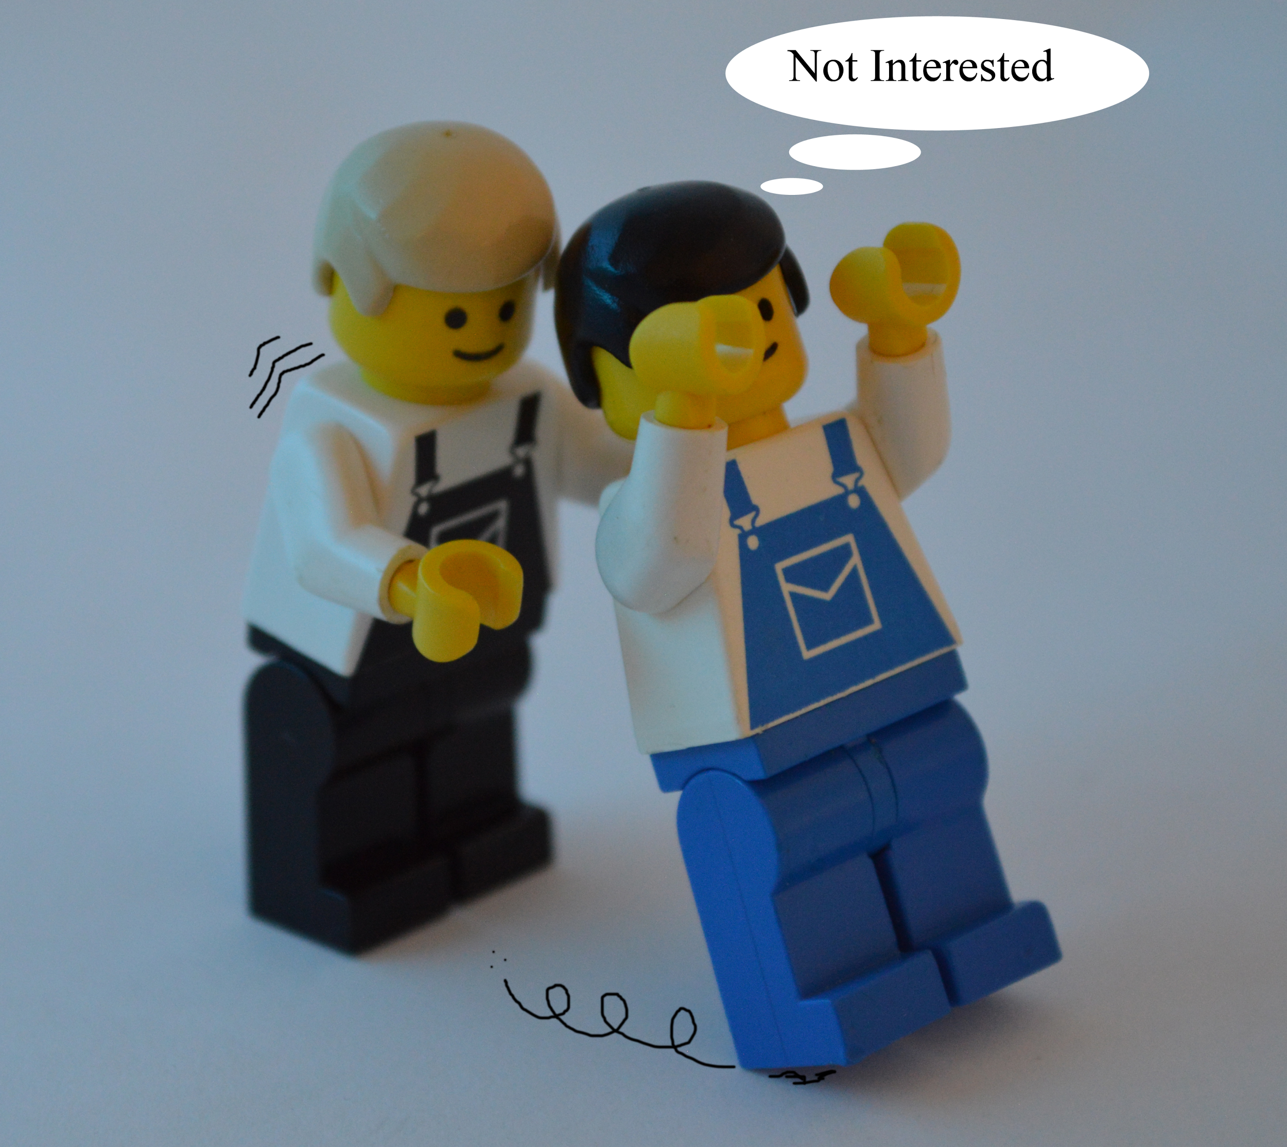
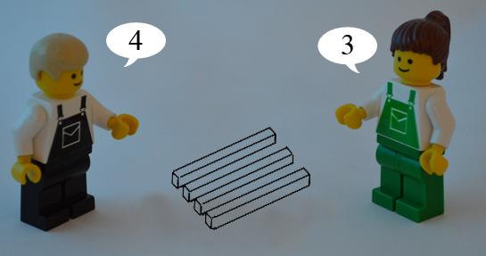
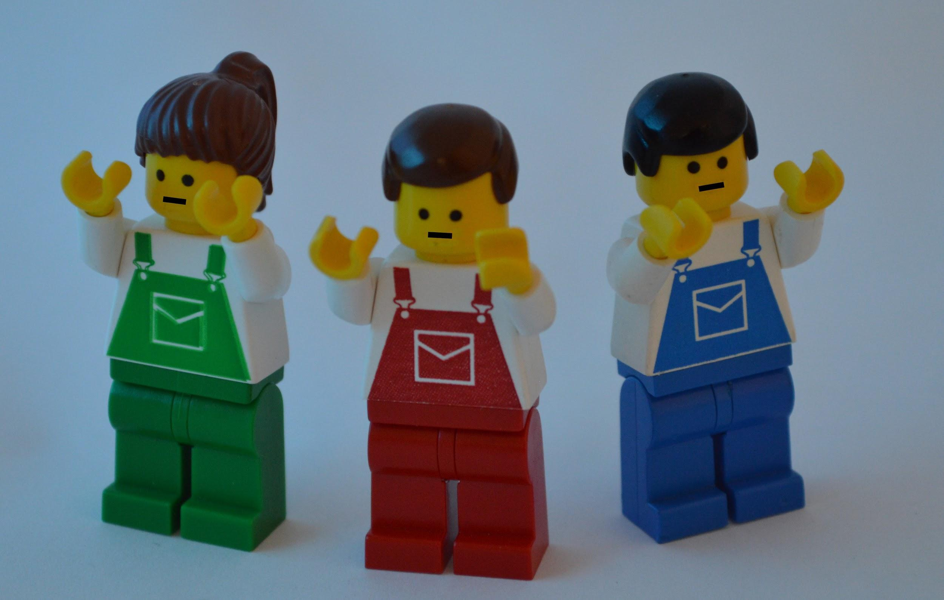
2012
Phil becomes QA manager for eCommerce and PM Solutions
Inherited Offshore Partners (Blue & Green)
Context-Driven Test Education
...now the fun begins

Slide 7
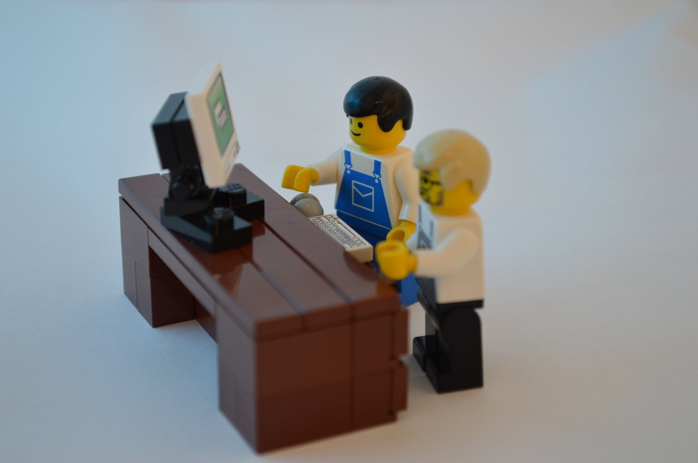

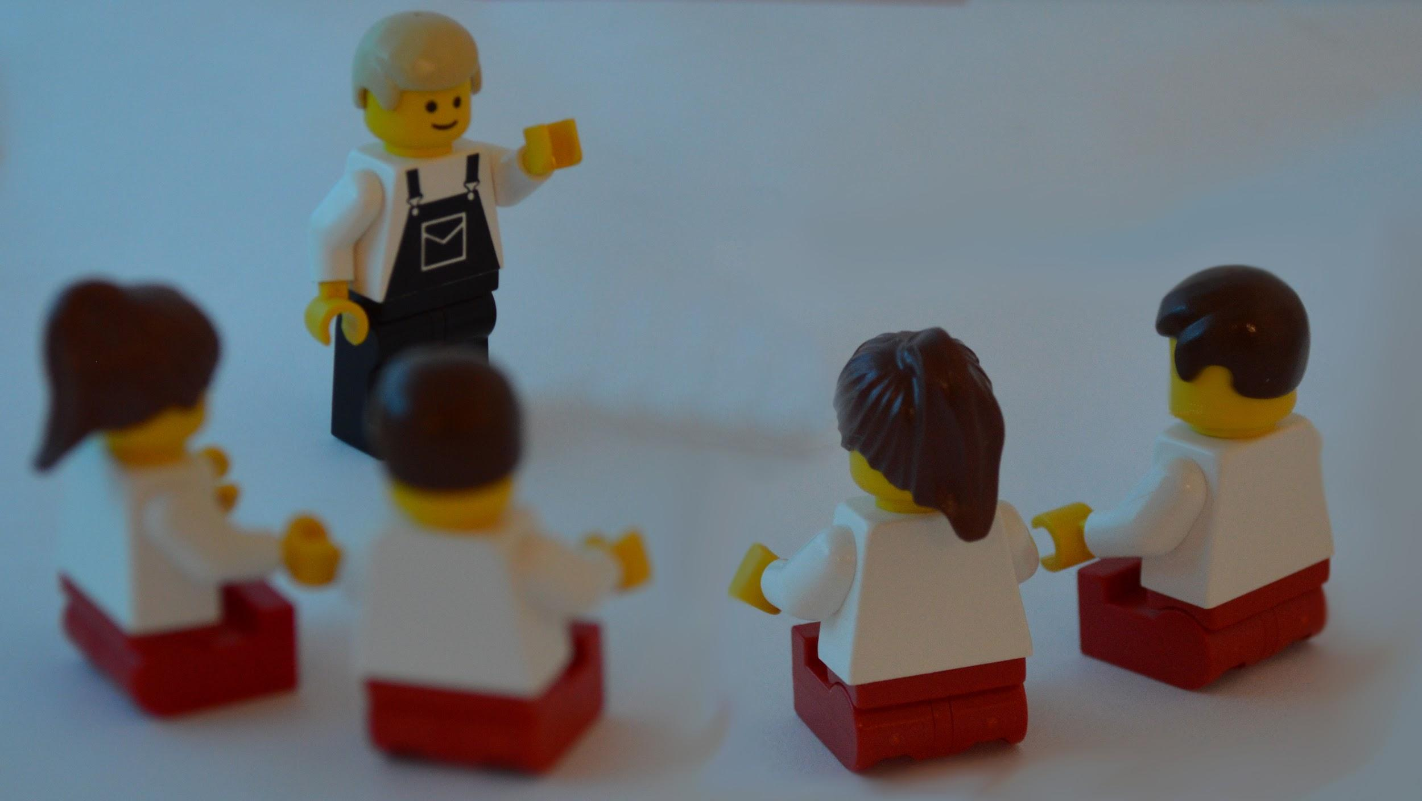
2013
Carl visits Team Red
Team Blue attempted automation
Team Blue adds Senior QC Analyst
Expectation Mandate
Team Green begins large new project

Slide 8
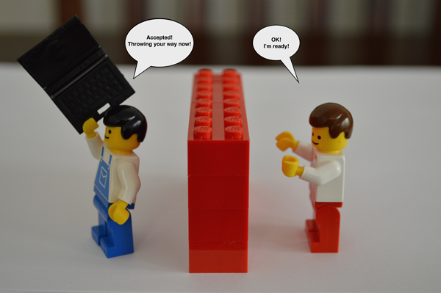
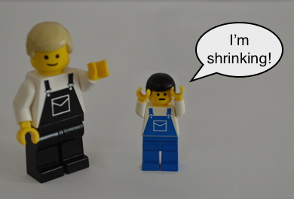
2014
Team Blue Acceptance/Team Red Regression
Removal of Senior QC Analyst
Changed leadership at Team Blue
Began reduction of Team Blue
Regressed to old ways

Slide 9
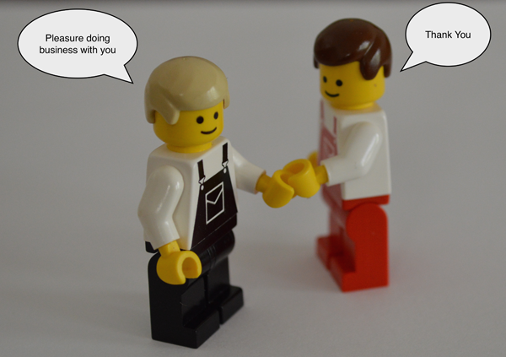
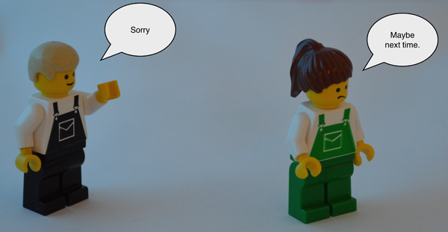
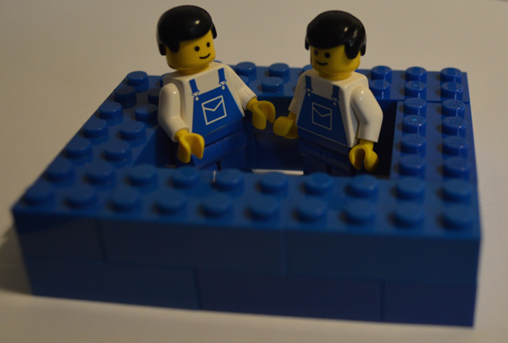
2015
Release of Team Green
Expansion of Team Red
Team Blue Productization movement

Slide 10
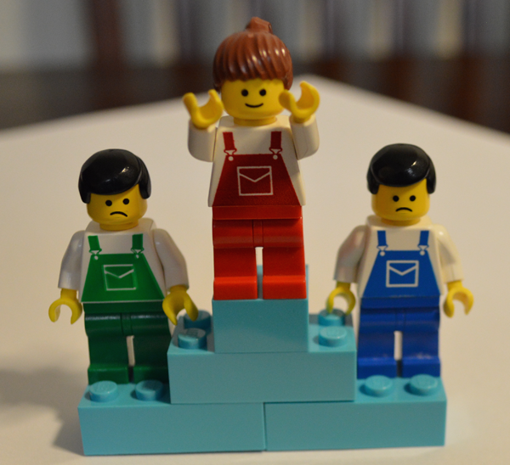
Lessons Learned
Proactive training by a partner
Personal visit and presentations seem to be important
Continuous Engagement
Building trust with Management
Staff Adjustments
Change Partners

Slide 11

Open Season

